Slide 1
Foundations of Psychological Testing
Chapters 5-6
Test Interpretation & Reliability

Slide 2
Definitions
Measurement: using numbers to better analyze and interpret data
  “Measurement”= numbers
Levels of Measurement: relationship among these numbers assigned to the data
  Use numbers at Test Item Level
    Each item on a test has a value, placeholder, etc.
  Scale Level
    Individual scores are combined to produce a final score for the test-taker
  Test Result Level
    Test-taker scores are then compared to standard scores (existing scores)

Slide 3
Scales
Nominal
Ordinal
Rank ordering of date, distance between numbers can vary or not be equal
  Ranking selections
  Likert Scale
Statistics
  Frequency
  Mode
  Median
  Percentile
  Rank-order Correlation
Numbers assigned to represent categories or labels of data
  Yes/No
  Multiple Choice
  True/False
Statistics
  Frequency
  Mode
  Chi-Square

Slide 4
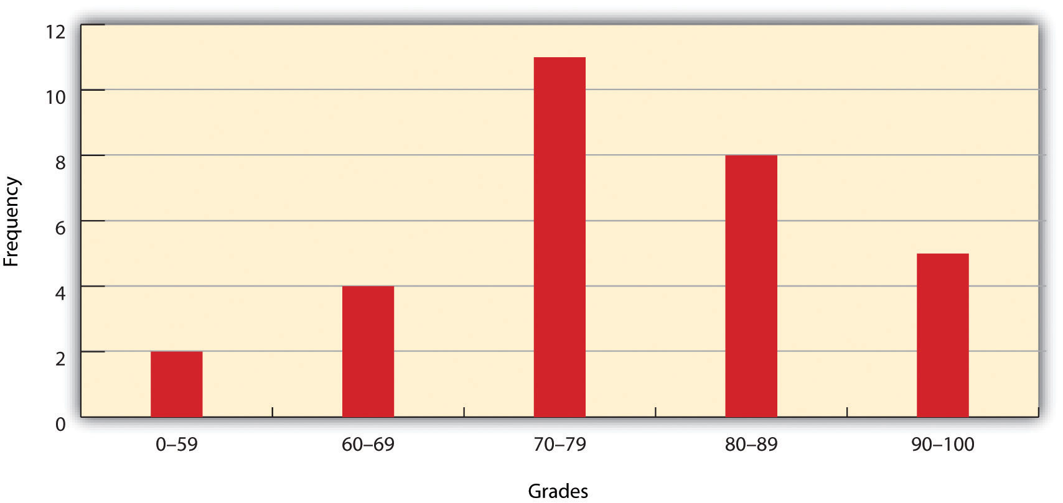
Frequency
Orderly arrangement of scores by grouping numbers
Shows actual numbers that fall into each category

Slide 5
Scales
Interval
Ratio
Numbers assigned to rank-order data but intervals are equal
  No absolute Zero, indicating a total absence of what is being measured
  Scale: A-?/1-?
Statistics
  Frequency
  Mean, Median Mode
  Standard Deviation
  Pearson Correlation
  t test, F test
Numbers assigned to rank-order, distance is equal, absolute Zero
  Questions with specific correct answers
Statistics
  Frequency
  Mean, Median, Mode
  Standard Deviation
  Pearson Correlation
  Proportion
  t test, F test

Slide 6
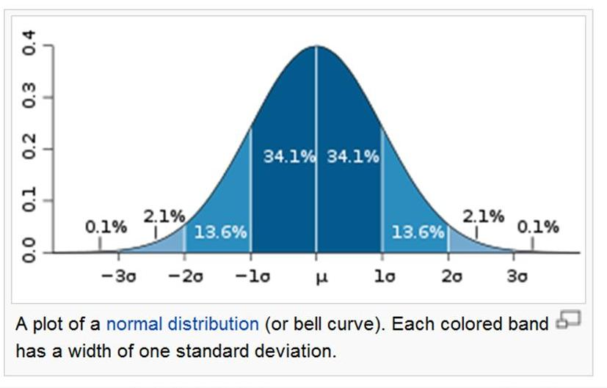

Slide 7
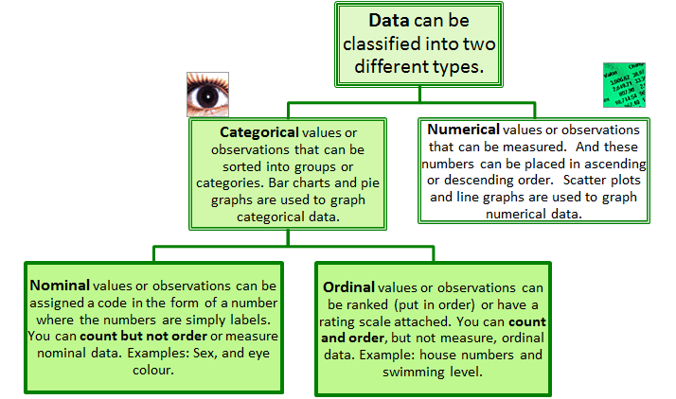
Categorical Data
Nominal Scales
According to common property
Data reported in terms of occurrences in each category
OR Most frequent occurrence(s)

Slide 8
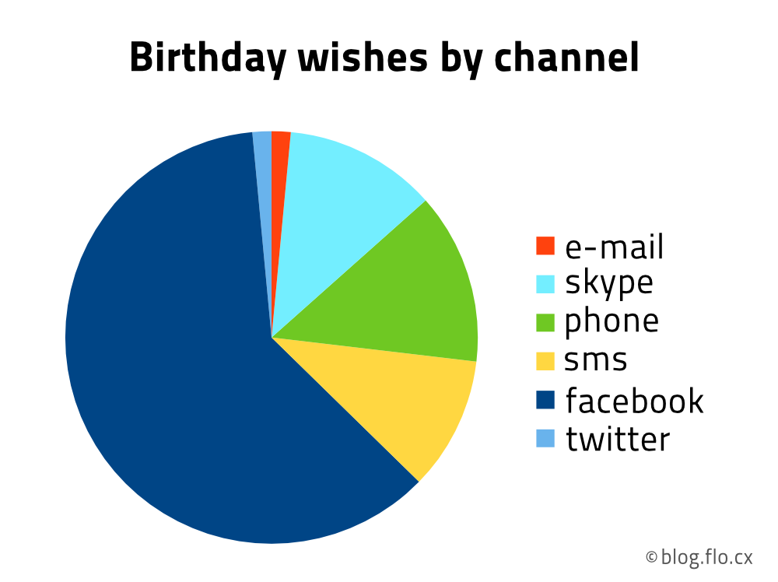

Slide 9
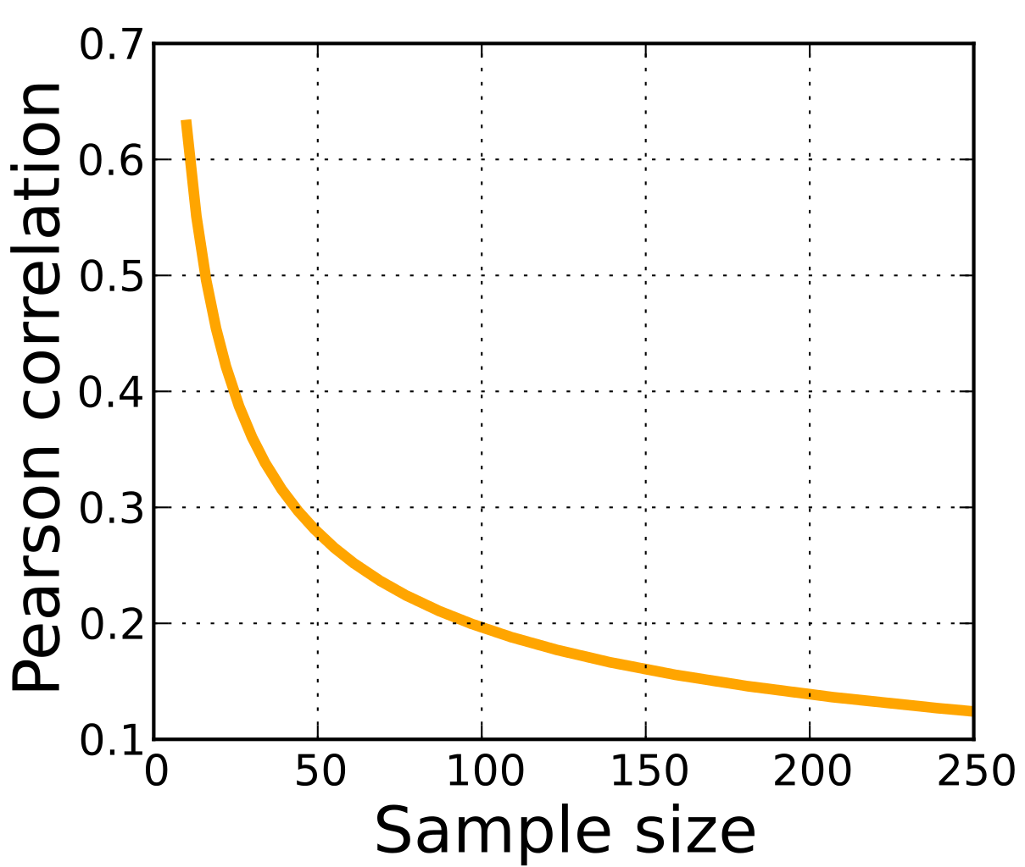
This Photo by Unknown Author is licensed under CC BY-SA

Slide 10
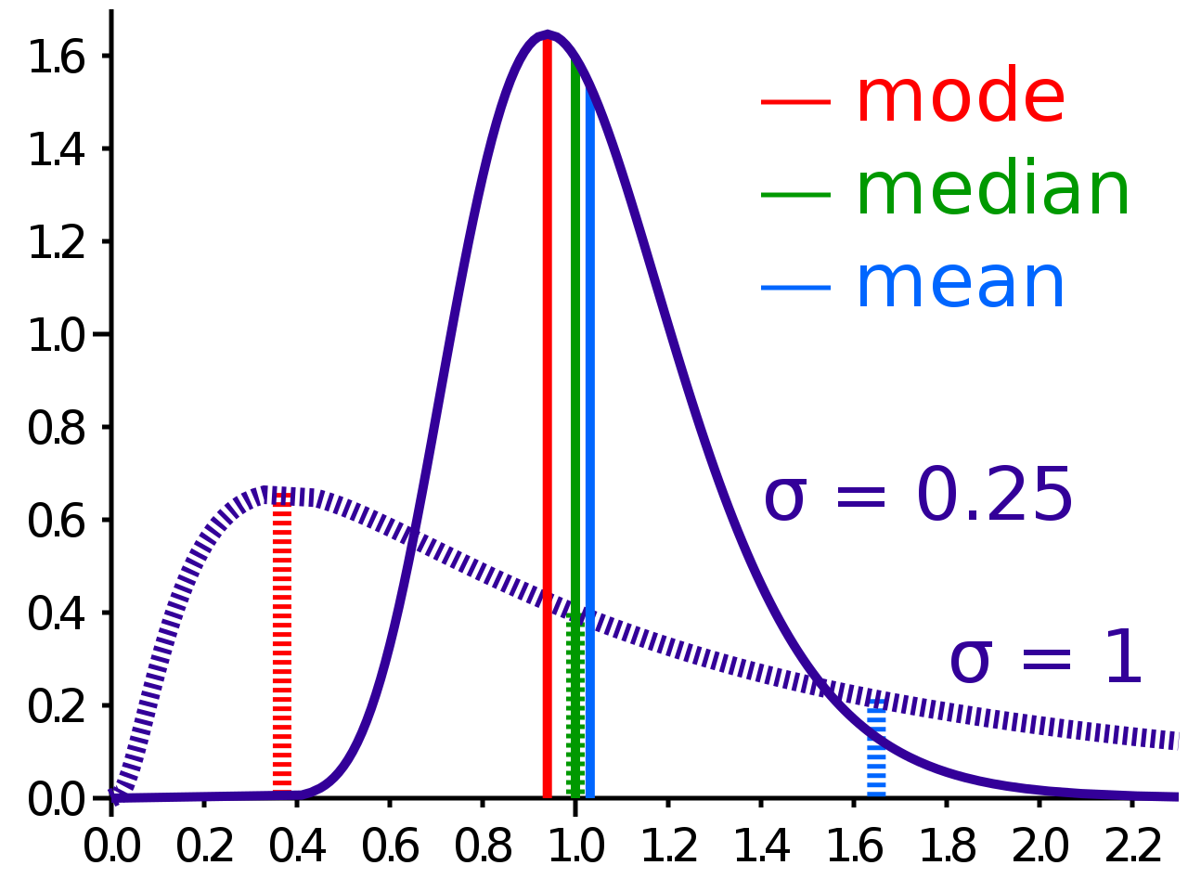
Mean, Median, Mode
Mean: Adding all score and dividing by number of scores
Median: Middle score of a group of scores
Mode: Most common score

Slide 11
Reliability/Precision
Consistency of Test Scores
How accurate is the data from a test
Avoiding error
3 Categories of tests for reliability
  Test-Retest Method
  Alternate Forms
  Internal Consistency Method

Slide 12
Test-Retest Method
Test is given to same group of test-takers on 2 separate occasions
Scores from 2 tests are correlated
Interval between testing causes changes to scores over time.
Longer the interval, greater the change in score differences.
Practice Effects: Scoring higher due to practice of taking the test and ability to solve the problems more quickly

Slide 13
Alternate Forms
Parallel forms
Developer creates 2 forms of the test
Sets of scores from both tests are correlated
Problems:
  2 forms are not equal in difficulty
  Pre-/Post-tests: familiarity with the test

Slide 14
Internal Consistency Method
How the items on the test are related to each other
Test questions have a commonality
Is the test assessing an ability or knowledge as expected

Slide 15


